Slide 1
Source Code Management
(SCM)
Team Details:
Aryan Sanghi (2410990186)(Team Lead)
Chirag Khosla (2410990220)
Guransh Singh Saluja (2410990226)
Chirag Sharma (2410990221)
Ayush Gupta (2410990189)
Faculty Coordinator: Renu Popli
:
Chitkara University Institute of Engineering and Technology,
Chitkara University, Punjab

Slide 2
Project Overview
Online Portfolio
Our project, Online Portfolio, serves as a professional showcase of our web development skills, creativity, and technical expertise. This platform allows users to explore our past projects, services, and experiences in an interactive and visually appealing manner.
With a focus on modern web technologies, our portfolio highlights expertise in HTML, CSS, JavaScript, UI/UX design, and full-stack development. It features a seamless navigation system, dynamic project displays, and an engaging user experience to leave a lasting impression on visitors.
This project not only represents our technical capabilities but also provides a foundation for continuous learning and innovation. By integrating responsive design and interactive elements, we aim to demonstrate our commitment to excellence in web development.

Slide 3
Team Structure
1)Aryan Sanghi
Power Point Presentation,Making of the Portfolio Pdf,Help in coding and Git hub commits.
2)Chirag Khosla
Coding(html,css),Help in Power Point Presentation and Git hub Commits.
3)Ayush Gupta
Coding(Frontend),Website photo upload option and
Git hub commits , HTML and CSS , PPT.
4)Guransh Singh Saluja
Coding(Backend),Git hub commits.
5)Chirag Sharma
Coding(Backend),Git hub commits.

Slide 4
Problem Statement
An online portfolio serves as a digital representation of an individual’s work, skills, and achievements, providing a structured way to showcase expertise to potential employers, clients, or collaborators.
Lack of a Centralized Showcase: Many individuals struggle to present their skills, projects, and achievements in a structured and visually appealing manner.
Limited Online Presence: Without a portfolio, professionals and creatives may miss opportunities to showcase their work to potential clients, employers, or collaborators.
Difficult Navigation & Accessibility: Existing portfolio platforms may not provide an intuitive interface, making it hard for users to organize and present their work effectively..

Slide 5
Technologies Used
HTML
CSS
JAVASCRIPT
Used for structuring the content of the website
Employed for styling and layout to enhance the visual appeal of the site
creating interactive and dynamic web pages

Slide 6
Contributions
Team Members | Contributions
Chirag Khosla | Website Design,Frontend Development
Aryan Sanghi | Website Design,Frontend Development
Ayush Gupta | Website Design , Frontend,Javascript, Html , css Coding
Guransh Singh | Backend Logic,Javascript Coding
Chirag Sharma | Backend Logic,Javascript Coding

Slide 7
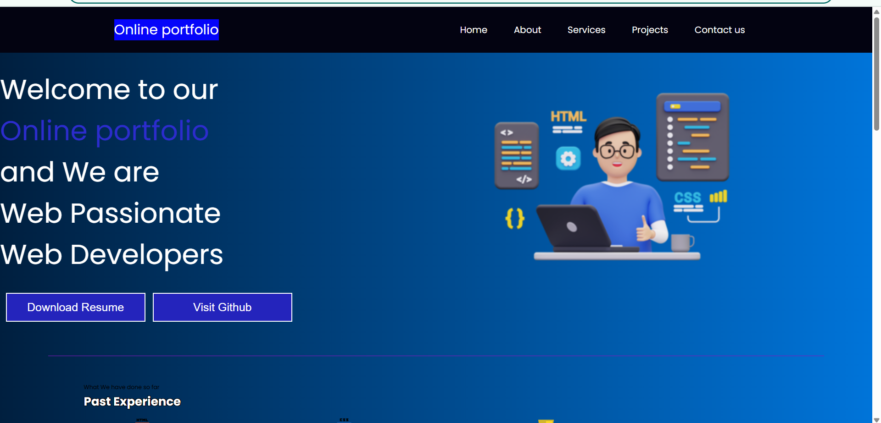
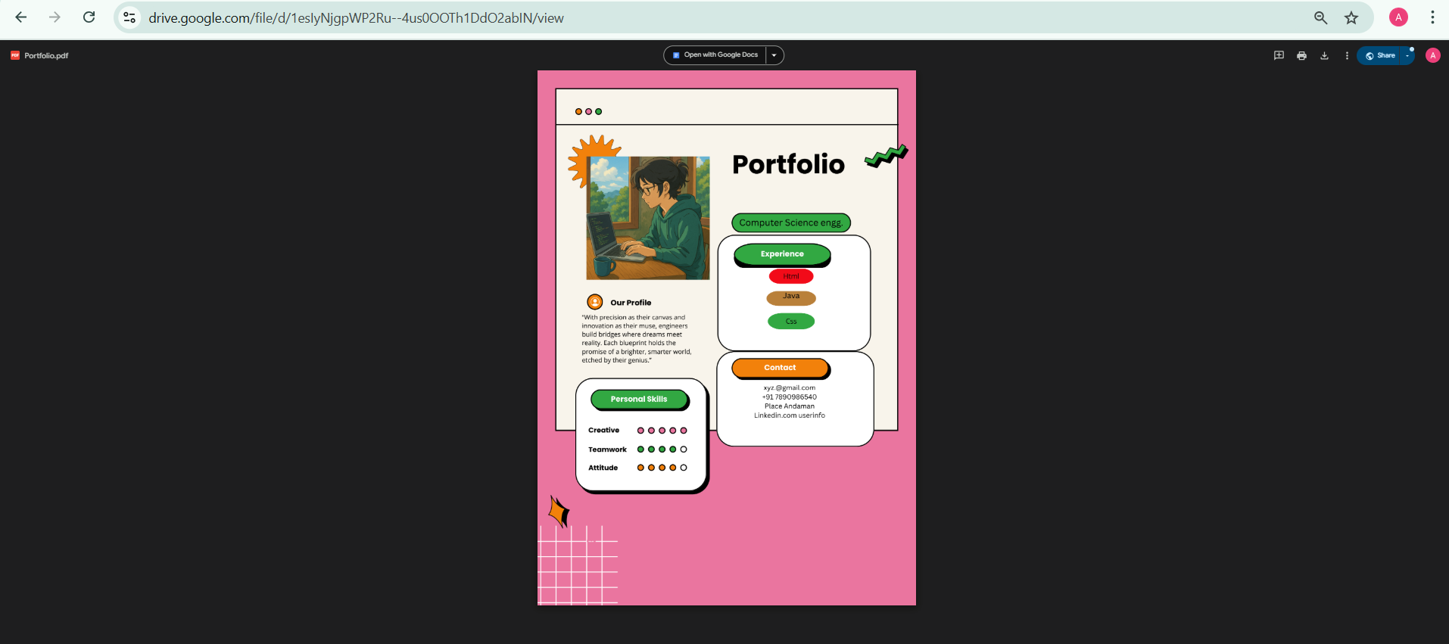
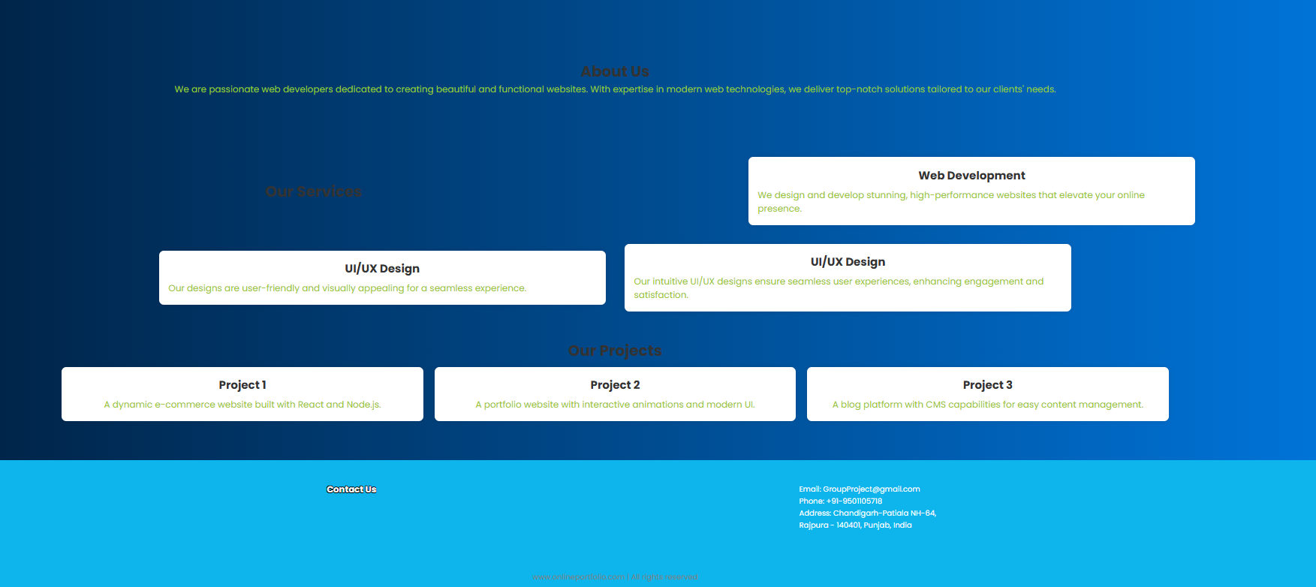
Website Insight

Slide 8
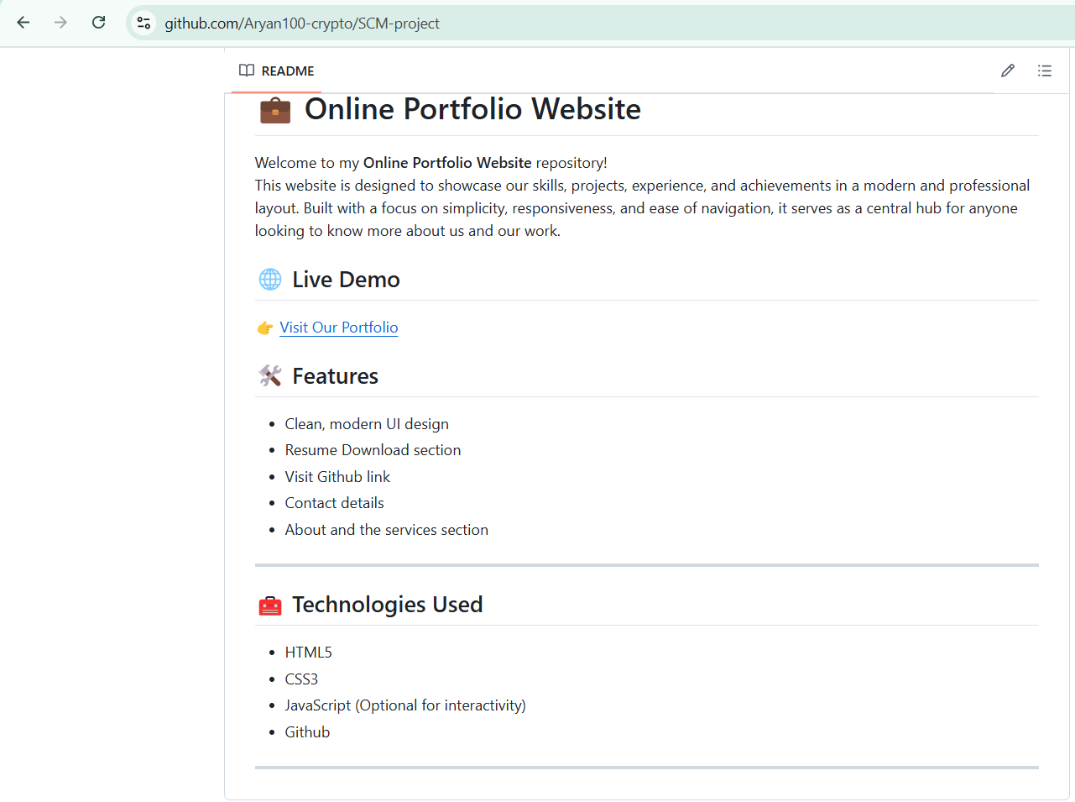
Project Team Readme.md File
Readme . md file link :
https://github.com/Aryan100-crypto/SCM-project/blob/main/README.md

Slide 9
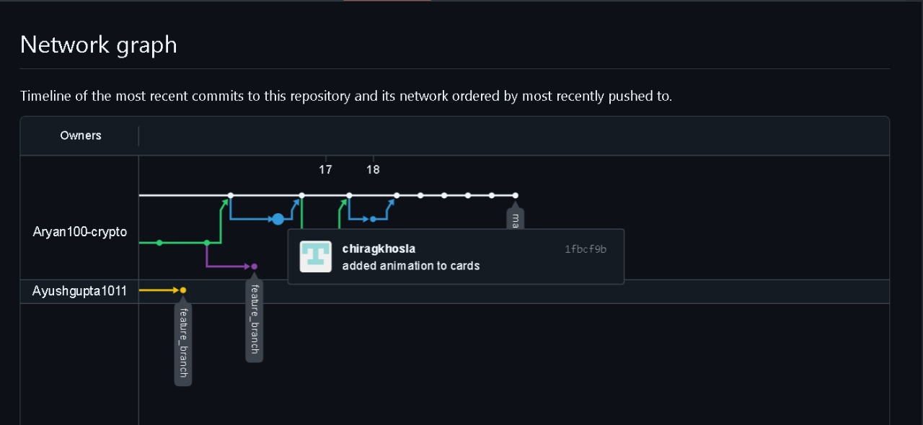
Project Repository Network Graph

Slide 10
Project Final Output
Gained hands-on experience with HTML, CSS, and responsive web design.
Understood the importance of UI design in creating user-friendly websites.
Learned to structure code effectively using a modular and maintainable layout.
Improved skills in using Git and GitHub for version control and collaboration.
Discovered how to deploy a static site using GitHub Pages.
Learned to debug layout issues across different devices and screen sizes.
Understood how to optimize images and assets for better performance.
Enhanced understanding of real-world project planning, organization, and execution.
Experienced the importance of clean, readable code for future updates and scalability.

